Slide 1

LINEAR REGRESSION
Of JFK Airport Data

Slide 2
The Dataset
Spans from nov 2019 to dec 2020
Features: Wind speed, temp, airline carrier, etc.
We will be focusing on taxi out
Collection of conditions, airlines, wind speeds, etc. at JFK airport
Contains both numerical and non-numerical value so it required some changes for accurate analysis.

Slide 3
Heatmap
VALUES CLOSER TO 1 HAVE A POSITIVE CORRELATION
VALUES CLOSER TO -1 HAVE A NEGATIVE CORRELATION
FOR TAXI OUT, THE MAJORITY HAD A VALUE OF LESS THAN 0.10
TWO OF INTEREST ARE SCHEDULED DEPARTURE (0.19) AND WIND GUST (0.10)

Slide 4
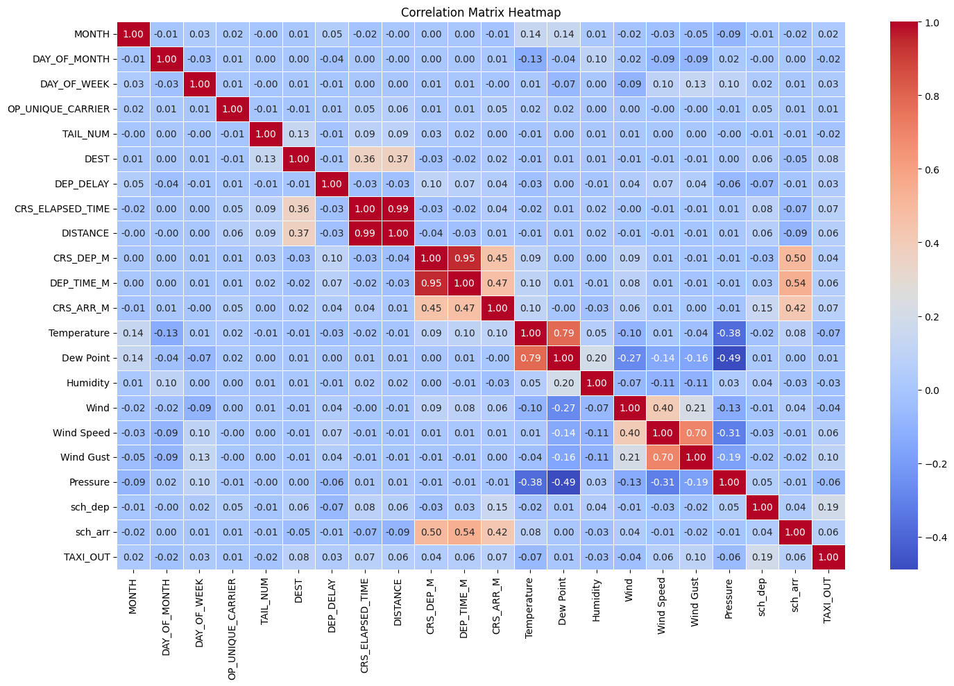

Slide 5
Method:
Train the model on the data
1
Have it make predictions
2
Compare actual values to predictions
3
Linear Regression

Slide 6
RESULTS
WE LOOK AT R SQUARED ERROR TO DETERMINE MODEL’S ACCURACY
CLOSER TO 1 IS BETTER
OUR MODEL PRODUCED A 0.036
THIS MEANS THAT SCHEDULED DEPARTURE ISN’T A GOOD WAY OF PREDICTING TAXI OUT
WE COULD LOOK INTO OTHER MODELS IN THIS CASE AS NONE OF THE OTHER FEATURES HAD A HIGH CORRELATION IN THE HEATMAP

